Slide 1
Software Quality Assurance and Testing Lecture - 04
ABDUS SATTER
LECTURER
INSTITUTE OF INFORMATION TECHNOLOGY
UNIVERSITY OF DHAKA

Slide 2
Dynamic Testing
WHITE BOX TESTING TECHNIQUES

Slide 3
White Box Testing
White-box testing techniques are used for testing the module for initial stage testing. Black-box testing is the second stage for testing the software. Though test cases for black box can be designed earlier than white-box test cases, they cannot be executed until the code is produced and checked using white-box testing techniques. Thus, white-box testing is not an alternative but an essential stage.

Slide 4
Logic Coverage Criteria
Structural testing considers the program code, and test cases are designed based on the logic of the program such that every element of the logic is covered. Therefore the intention in white-box testing is to cover the whole logic. The basic forms of logic coverage are
Statement Coverage
Decision or Branch Coverage
Condition Coverage
Decision/condition Coverage

Slide 5
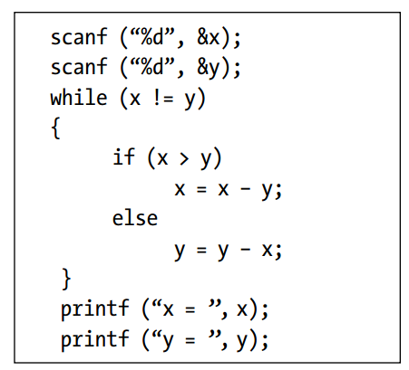
Statement Coverage
Test case 1: x= y= n, where n is any number
Test case 2: x= n, y= n’, where n and n’ are different numbers.
Test case 3: x > y
Test case 4: x < y

Slide 6
Decision or Branch Coverage
Test case 1: x= y
Test case 2: x!= y
Test case 3: x < y
Test case 4: x > y

Slide 7
Condition Coverage
Condition coverage states that each condition in a decision takes on all possible outcomes at least once. For example, consider the following statement:
while ((I <5) && (J <COUNT))
In this loop statement, two conditions are there. So test cases should be designed such that both the conditions are tested for True and False outcomes.
The following test cases are designed:
Test case 1: I <5, J <COUNT
Test case 2: I >5, J >COUNT

Slide 8
Decision/condition Coverage
if (A && B) is being tested, the condition coverage would allow one to write two test cases:
Test case 1: A is True, B is False.
Test case 2: A is False, B is True.
But these test cases would not cause the THEN clause of the IF to execute (i.e. execution of decision). The obvious way out of this dilemma is a criterion called decision/condition coverage. It requires sufficient test cases such that each condition in a decision takes on all possible outcomes at least once, each decision takes on all possible outcomes at least once, and each point of entry is invoked at least once
Test case 1: A is True, B is True
Test case 1: A is False, B is False

Slide 9
Multiple Condition Coverage
In case of multiple conditions, even decision/condition coverage fails to exercise all outcomes of all conditions. The reason is that we have considered all possible outcomes of each condition in the decision, but we have not taken all combinations of different multiple conditions. Certain conditions mask other conditions. For example, if an AND condition is False, none of the subsequent conditions in the expression will be evaluated. Similarly, if an OR condition is True, none of the subsequent conditions will be evaluated.
For (A && B)
Test case 1: A= True, B= True
Test case 2: A= True, B= False
Test case 3: A= False, B= True
Test case 4: A= False, B= False

Slide 10
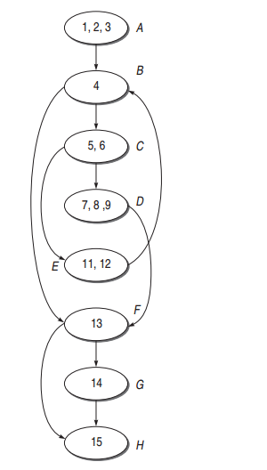
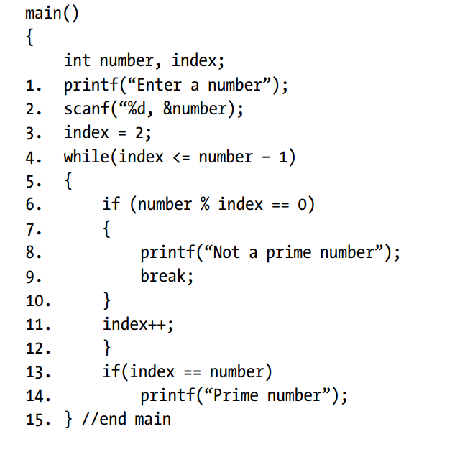
CFG

Slide 11
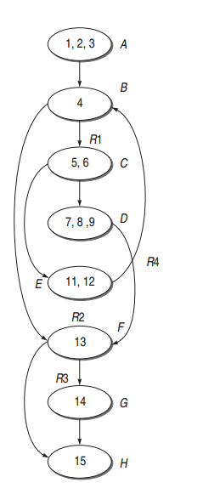

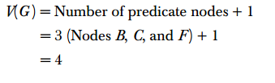

Cyclomatic Complexity

Slide 12
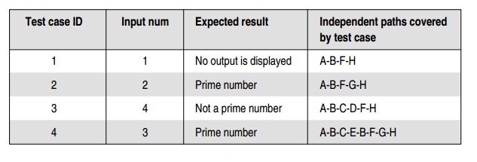
Independent Path & Test Cases
(i) A-B-F-H
(ii) A-B-F-G-H
(iii) A-B-C-E-B-F-G-H
(iv) A-B-C-D-F-H

Slide 13
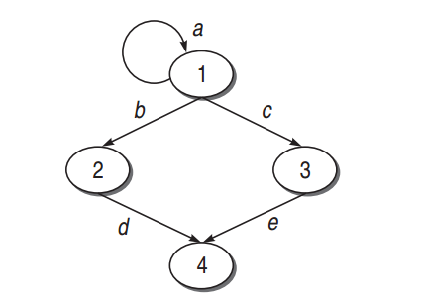
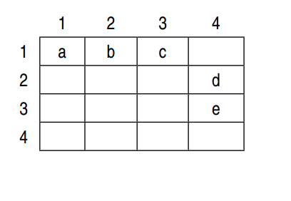
Graph Matrix

Slide 14
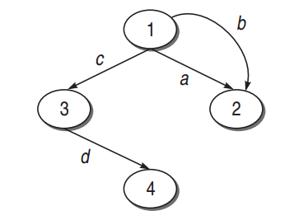
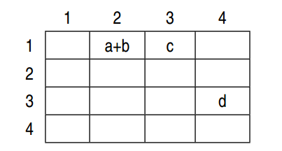
Graph Matrix

Slide 15
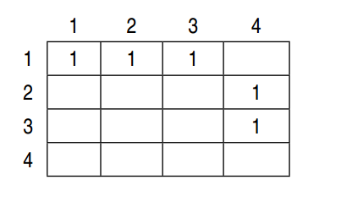
Connection Matrix

Slide 16
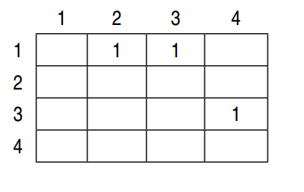
Connection Matrix

Slide 17
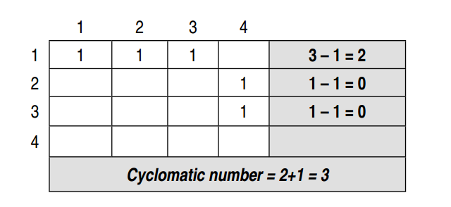
Use Of Connection Matrix In Finding Cyclomatic Complexity Number

Slide 18
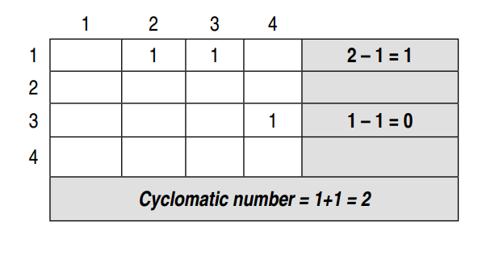
Use Of Connection Matrix In Finding Cyclomatic Complexity Number

Slide 19
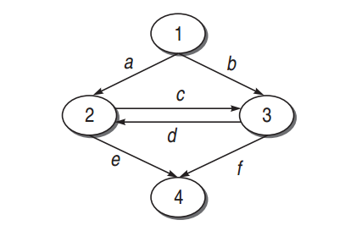
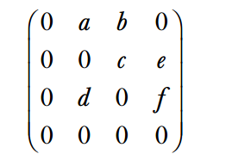
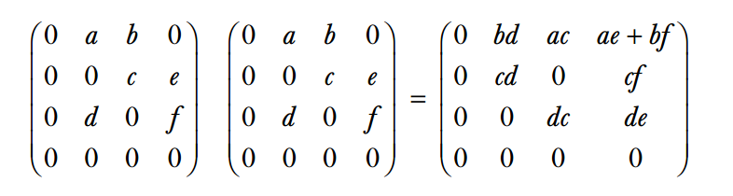
Use of Graph Matrix to Find K-Link Paths

Slide 20
Loop Testing (Simple Loop)
Check whether you can bypass the loop or not. If the test case for bypassing the loop is executed and, still you enter inside the loop, it means there is a bug.
Check whether the loop control variable is negative.
Write one test case that executes the statements inside the loop.
Write test cases for a typical number of iterations through the loop.
Write test cases for checking the boundary values of the maximum and minimum number of iterations defined (say min and max) in the loop. It means we should test for min, min+1, min−1, max−1, max, and max+1 number of iterations through the loop.

Slide 21
Loop Testing (Nested Loop)
Adopt the approach of simple tests to test the nested loops
Start with the innermost loops while holding outer loops to their minimum values
Continue this outward in this manner until all loops have been covered

Slide 22

Data Flow Testing
Potential Bug

Slide 23
State Of A Data Object
Defined (d): A data object is called defined when it is initialized, i.e. when it is on the left side of an assignment statement. Defined state can also be used to mean that a file has been opened, a dynamically allocated object has been allocated, something is pushed onto the stack, a record written, and so on [9].
Killed/Undefined/Released (k): When the data has been reinitialized or the scope of a loop control variable finishes, i.e. exiting the loop or memory is released dynamically or a file has been closed.
Usage (u): When the data object is on the right side of assignment or used as a control variable in a loop, or in an expression used to evaluate the control flow of a case statement, or as a pointer to an object, etc. In general, we say that the usage is either computational use (c-use) or predicate use (p-use).

Slide 24
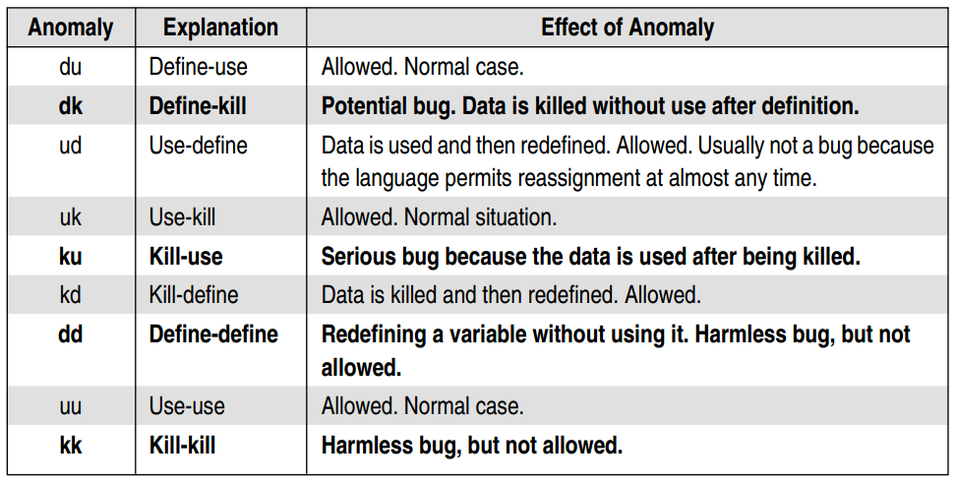
Data-Flow Anomalies

Slide 25
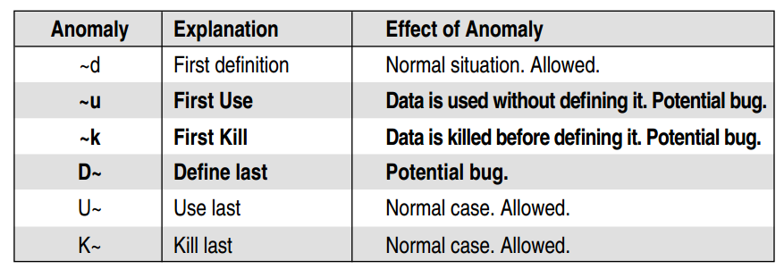
Data-Flow Anomalies
~x: indicates all prior actions are not of interest to x.
x~ : indicates all post actions are not of interest to x.

Slide 26
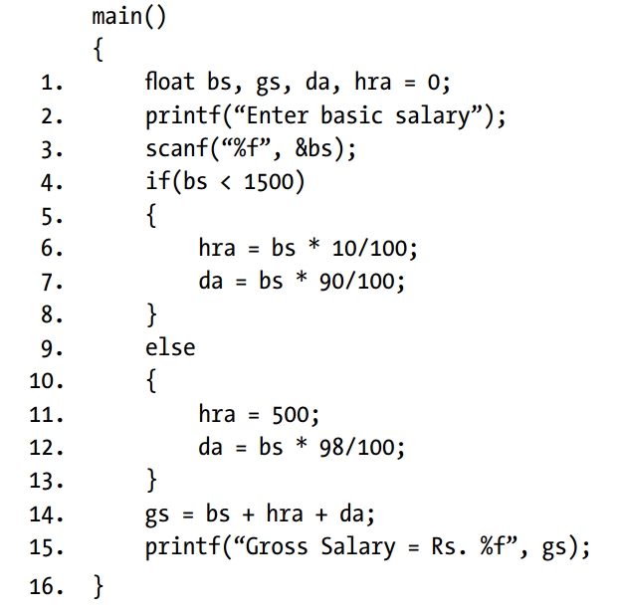
Data Flow Testing
For Variable bs
Pattern | Line Number | Explanation
~d | 3 | Normal Case, Allowed
du | 3-4 | Normal Case, Allowed
uu | 4-6, 6-7, 7-14, 4-12, 12-14 | Normal Case, Allowed
uk | 14-16 | Normal Case, Allowed
K~ | 16 | Normal Case, Allowed

Slide 27
Mutation Testing
if (a > b)
x = x + y;
else
x = y;
printf(“%d”, x);
M1:x = x – y;
M2:x = x / y;
M3:x = x + 1;
M4:printf(“%d”, y);
Test Case ID | x | y | Initial Program Result | Mutant Result
TD1 | 2 | 2 | 4 | 0 (M1)
TD2 | 4 | 3 | 7 | 1.4 (M2)
TD3 | 3 | 2 | 5 | 4 (M3)
TD4 | 5 | 2 | 7 | 2 (M4)

Slide 28
Mutation Testing
Mutation testing is the process of mutating some segment of code (putting some error in the code) and then, testing this mutated code with some test data. If the test data is able to detect the mutations in the code, then the test data is quite good, otherwise we must focus on the quality of test data. Therefore, mutation testing helps a user create test data by interacting with the user to iteratively strengthen the quality of test data.

Slide 29
Thank You
END OF CHAPTER

